Slide 1
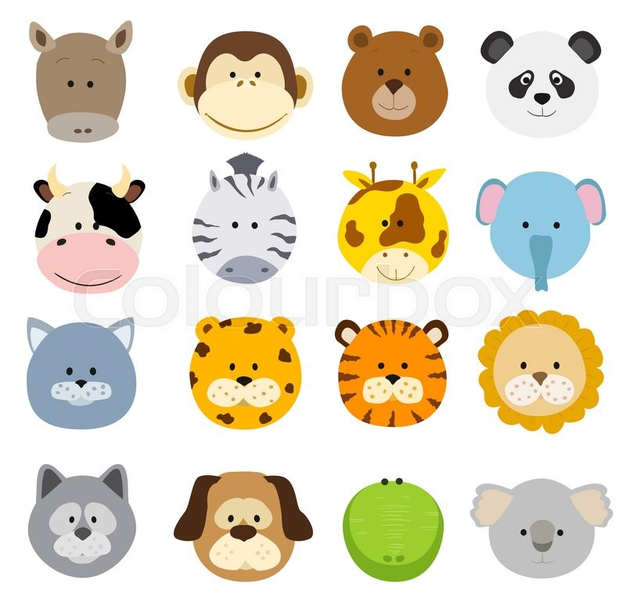
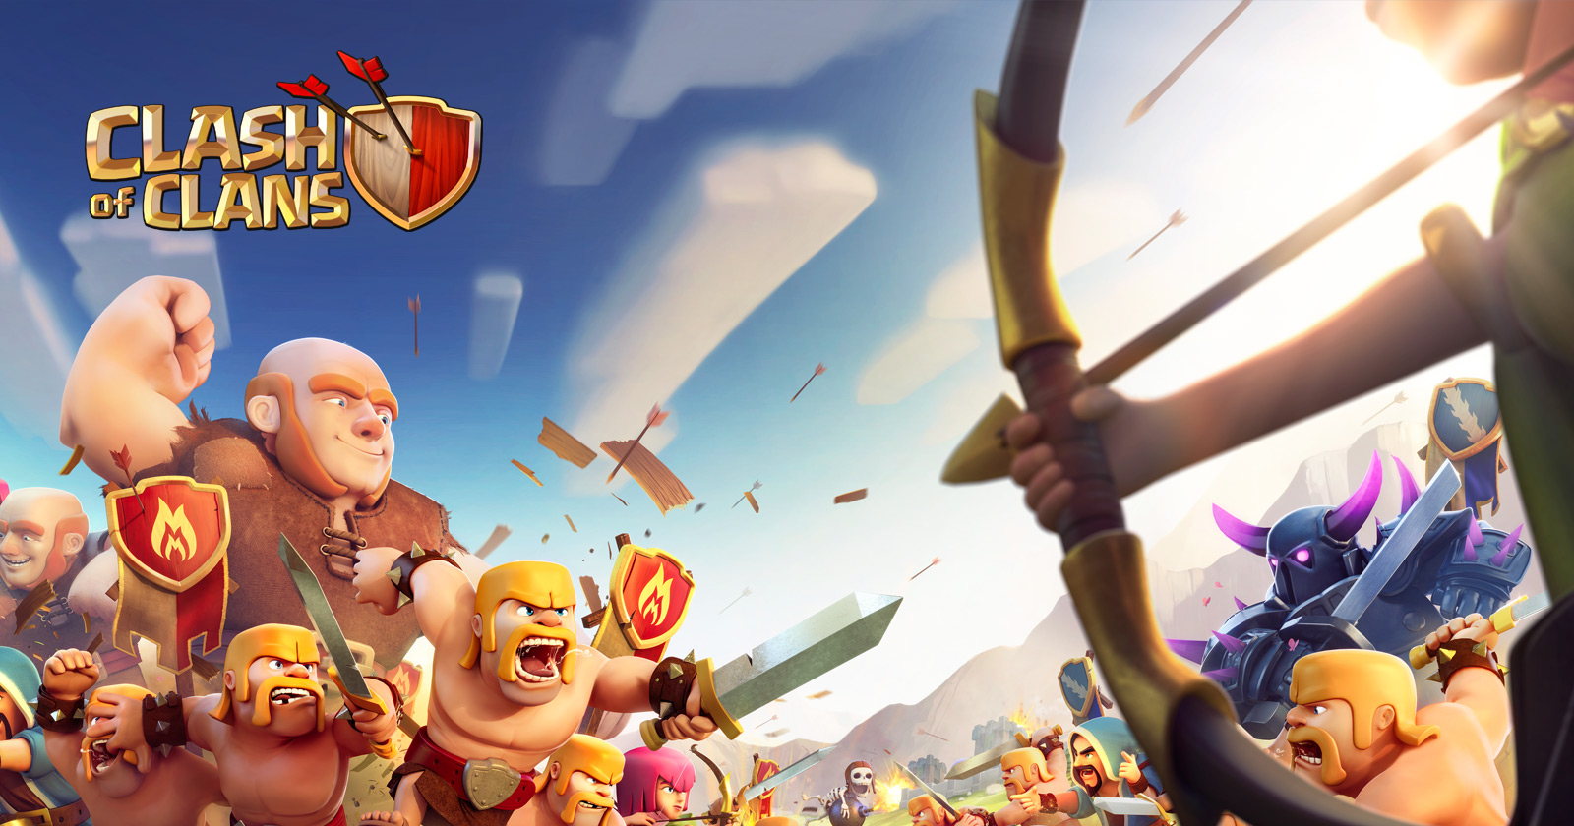

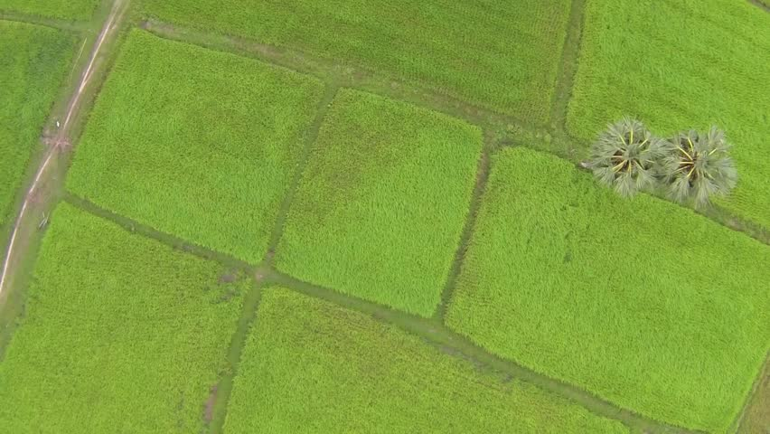
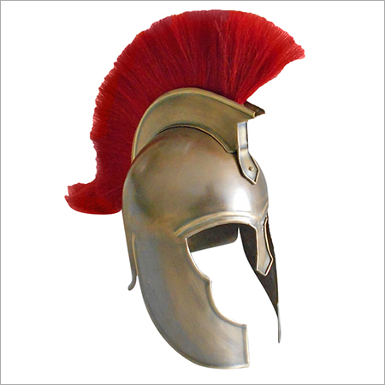
Player Characters could be customizable.
Game 1
Historical theme, already popular games with this theme so its likely to appeal to a similar audience
Animal themed, would likely be popular with children
Bugs, easy to turn into simple round designs, might appeal to casual gamers although might put off people afraid of certain bugs.
Simple minimalistic characters?
Could use medieval Armor to represent what location are and are not weak spots on a character.
Lends itself very well to traps.
Can easily lend themselves to a farm, savanna, etc themed stages

Slide 2
Target
Scarf/Headband
Trojan Helmet
Race Car
Potential Character Designs
Ladybug
Spider
Cat/Tiger
Portals that allow players to swap between both sides and a pit which players can fall into
Potential Stage Designs
Spike pit that switches on and off between turns
No Hazards, just walls

Slide 3
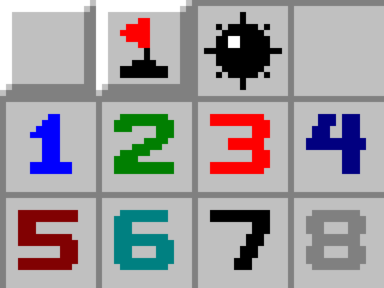
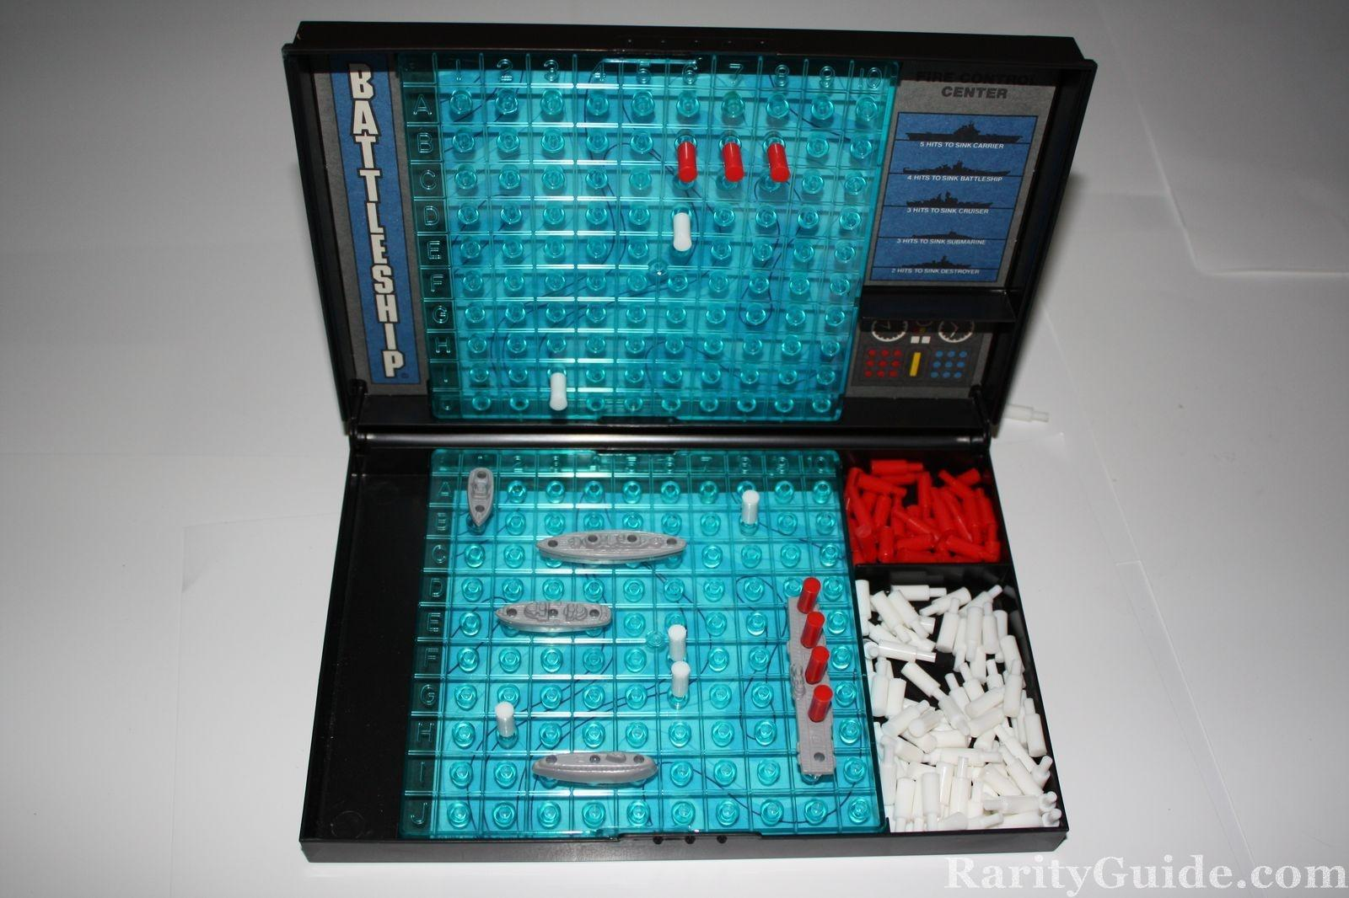
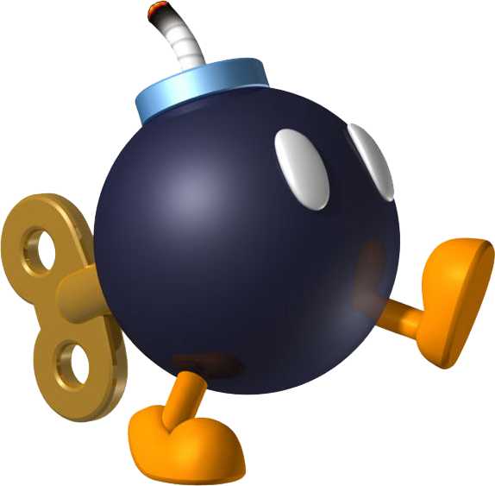
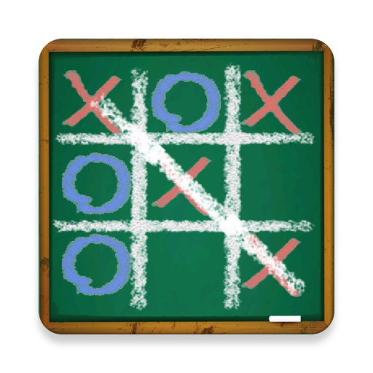
Game 2
Minesweeper, very popular amongst casual audiences, could use a flag rather than a character.
Ship theme, since the game is already based on battleships. Might not appeal to casual audiences however.
Bomb must be childish or cartoony and avoid realism, one way of doing this would be giving it a face like what is done in Mario
Must be easy to differentiate bomb and player
Chalkboard theme, easy to create, would likely appeal to both children and adults.

Slide 4
Various bomb designs, Spherical and Dynamite, similar to that which appeals in children's cartoons
Hand drawn theme?
Boats and sea mines, might not be as appealing as other designs
Flags can be recoloured to represent each player

Slide 5
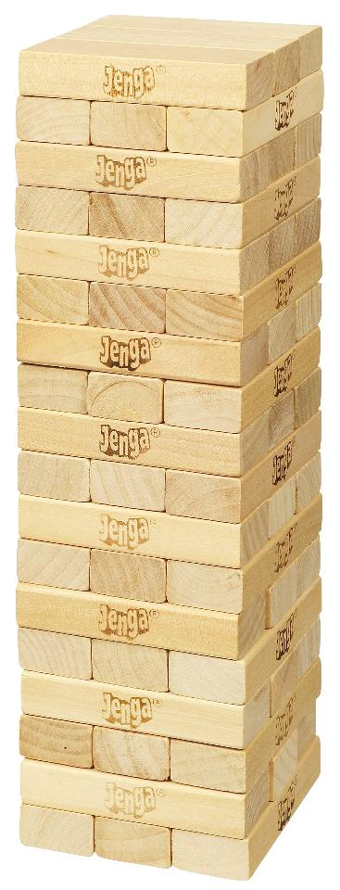
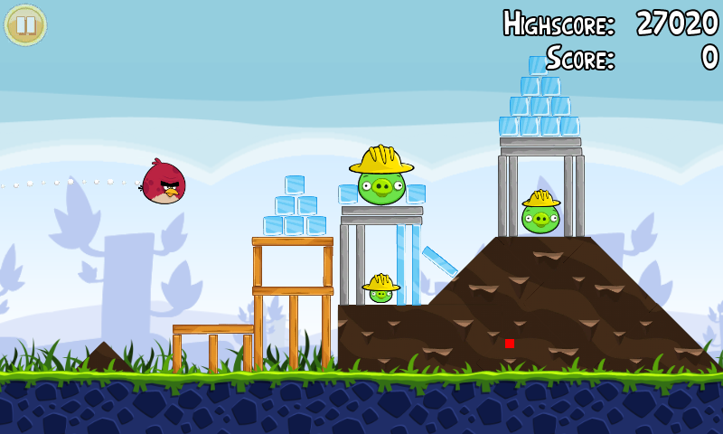
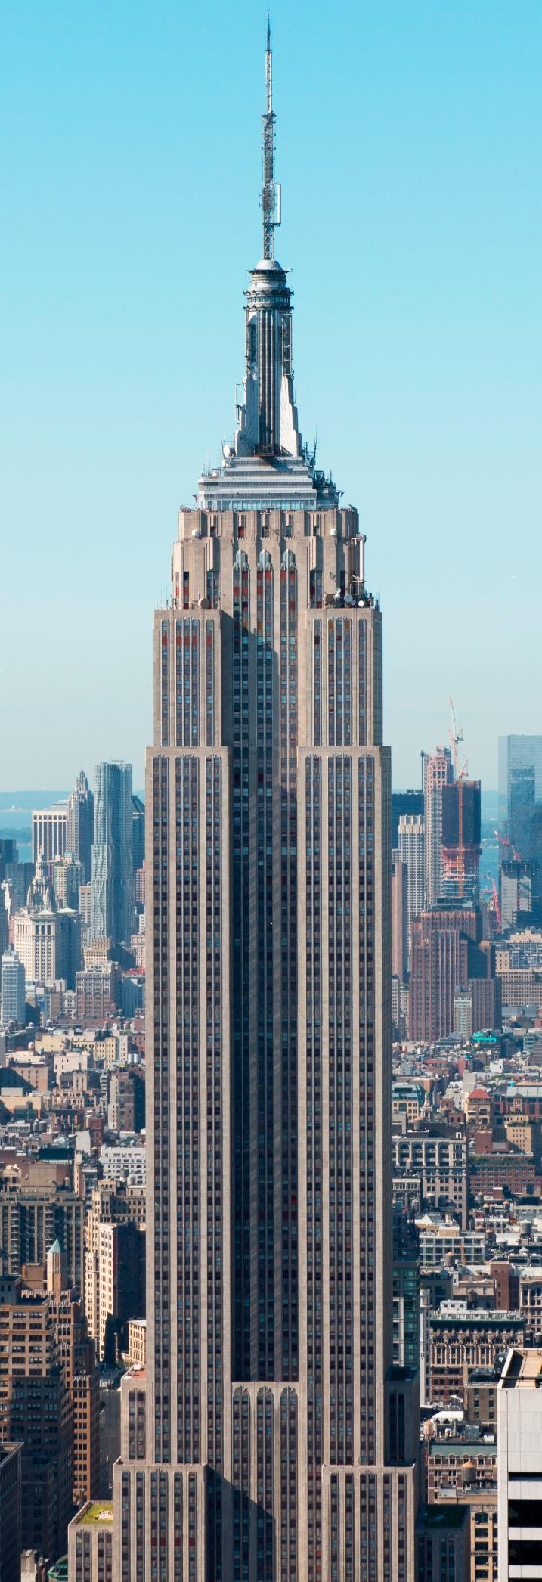
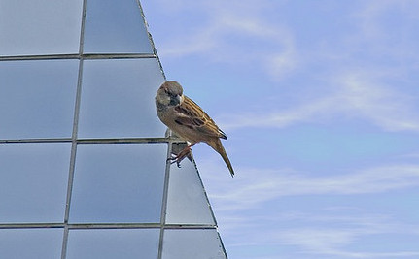
Game 3
Angry birds is very popular amongst casual gamers, it also has a similar reliance of physics, structure design could take inspiration.
Blocks made from wood by default, other materials represent other things
Cartoon versions of famous landmarks may not be a good idea (Since there being destroyed), However real buildings drawn as cartoons may also be a good idea for the structures.
Must be unrealistic
Birds could be used as the character, they could fly off when the block they stand on falls over or is crushed

Slide 6
Realistic construction style may not allow for create ideas
Bird
Wood = Standard Material
Stone = Heavy
Glass = Fragile
Other: Materials
Metal: Unbreakable
Ice: Slippery
Not living character,
Something famously fragile like a piggy bank.

Slide 7
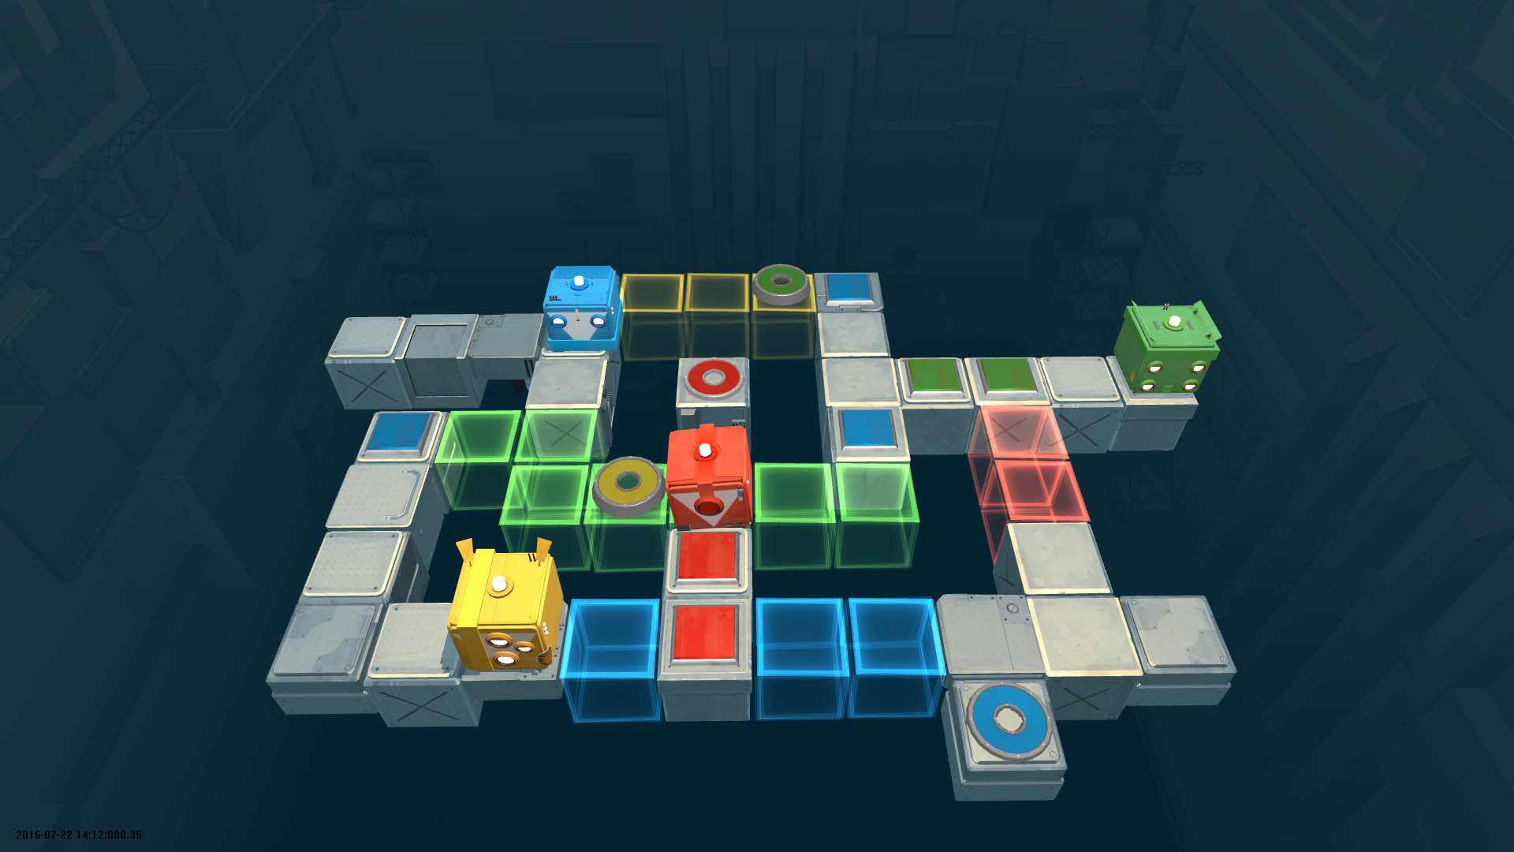
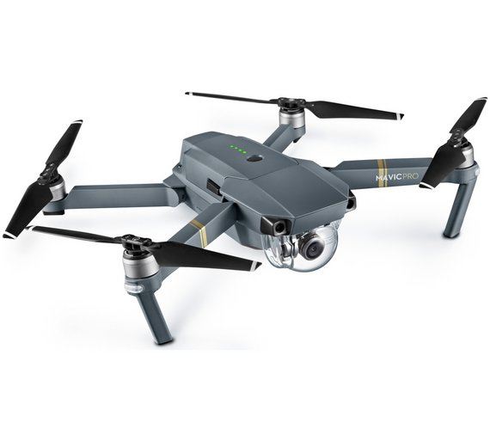
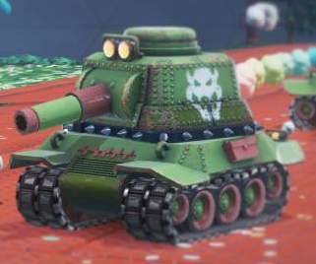
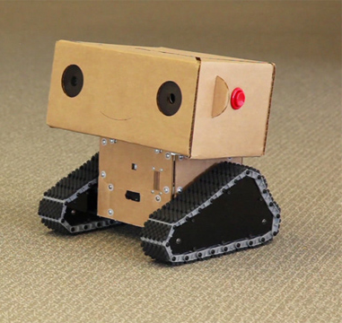
Game 4
Very unrealistic robots, a similar design could easily be translated to 2D
Drone, could be used for different level design however might not make as much sense with the rotating walls.
Designs must be Square, to fit the map
Tank, unrealistic tanks can be used in child friendly games, if we manage make an unrealistic tank it could open up some unique gameplay features with the turret
Tank treads would fit the square designs well

Slide 8
The tanks gun and robots arm can represent the forward direction
Simple tank design
Simple robot design.
Lights, enabled, Disabled and claimed.
At some points lights may be disabled, E.g. the first few turns.

